Slide 1
Module 8:
Views in MS SQL 2008

Slide 2
Objectives
After end of this session you will understand:
Explain Views
List the advantages of Views
List the disadvantages of Views
Working with Views

Slide 3
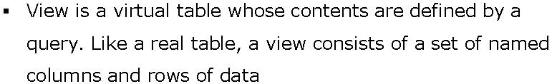
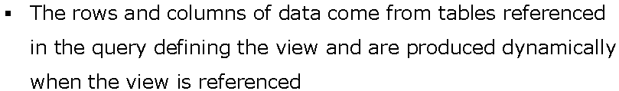
Views

Slide 4
Advantages of Views
To hide data complexity: Instead of forcing your users to learn the T-SQL JOIN syntax you might wish to provide a view that runs a commonly requested SQL statement.
To protect the data: If you have a table containing sensitive data in certain columns, you might wish to hide those columns from certain groups of users.
Customizing data: If you wish to display some computed values or column names formatted differently than the base table columns, you can do so by creating views.

Slide 5
Disadvantages of Views
Even though views can be a great tool for securing and customizing data, they can be slow. Indeed, they are not any faster than the query that defines them.
Views can especially degrade the performance if they are based on other views. Therefore, it is recommended NOT to create views based on other views. All views should be created against base tables.

Slide 6
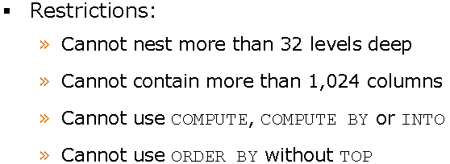
Syntax to create Views
Create view view_name
With encryption
As
Select column1,………..,columnn
From table_name

Slide 7
Display View Commands and Drop View
To display the creation code view after it has been created:
Sp_helptext view_name
Note: This will not display the code if view is created with encryption option.
To rename a view:
Sp_rename old_name,new_name
To drop the view:
Drop view view_name

Slide 8
Thank You…!

